Slide 1
Modeling data:
Introduction to Predictive Modelling
Tim Smith

Slide 2

Odysseus (also known by the Latin name Ulysses) was a legendary Greek king of Ithaca and the hero of Homer's epic poem the Odyssey. Odysseus also plays a key role in Homer's Iliad and other works in that same epic cycle.
In Homer’s Odyssey, Ulysses made a pact with his men as they approached the Sirens. Ulysses wanted to hear the Sirens' song although he knew that doing so would render him incapable of rational thought. He put wax in his men's ears so that they could not hear, and had them tie him to the mast so that he could not jump into the sea. He ordered them not to change course under any circumstances, and to keep their swords upon him and to attack him if he should break free of his bonds.
Upon hearing the Sirens' song, Ulysses was driven temporarily insane and struggled with all of his might to break free so that he might join the Sirens, which would have meant his death.

Slide 3
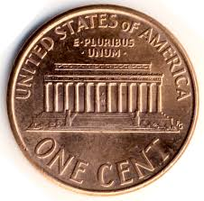
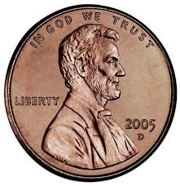
You’ve been asked if the following coin is a fair coin.
We know that all fair coins are 50/50 and we hold the assumption that most coins are fair.
Heads
Tails
Tails
Tails
Tails
If we have a fair coin, chance of getting this exact sequence is ½ * ½ * ½ * ½ * ½ = 1/32.
But, since we’re asking if this is a fair coin, we think in terms of 1 head out of 5, so position doesn’t matter. Therefore, the odds of getting only one head in 5 (if the coin was fair) is 5/32, or 15.625%
So, I ask “is it fair?” Do you feel the call of the sirens song?

Slide 4
A statistician and a data scientist watch this same sequence. The person flipping the coin then asked asks the statistician. “What will the result of the next coin flip” and the statistician says, these are independent events, and each coin toss have is 50/50 chance for heads or tails. This person then turns to the data scientist, and asks the same question. The data scientist says, “obviously you have a trick coin”.
BUT who is right?
… now, what would a “statistician” and a “data scientist” likely conclude?

Slide 5
Tie ourselves to the mast? Or listen to the sirens call?
This is an illustration of philosophical orientations about the world, and its consistencies. The data scientist is illustrating a more empirically based perspective – showing an inclination to give “what is observed” precedence over “what is supposed”, thus drawing theory from evidence. The statistician, on the other hand, is showing a tendency to give precedence to “what is supposed” (aka theoretical model), over “what is seen”.
At what point does the statistician doubt his/her model? At what point does the data scientist believe he/she has the correct model?
For further reading on these differing “philosophies” click here

Slide 6
Rational Choice Theory
Rational choice theory is an economic theory (principle) that states that individuals always make prudent and logical decisions. These decisions provide people with the greatest benefit or satisfaction — given the choices available — and are also in their highest self-interest.
But, why are many business decisions seemingly irrational?

Slide 7
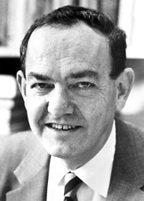
As we have seen – Bounded rationality
The rationality of individuals is bounded (limited) by cognitive limitations, limited time (budget), and limited access to information
Satisficing – Satisficing is a decision-making strategy that entails searching through the available alternatives until an acceptability threshold is met.
Herbert Simon
(1916-2001)
Therefore, our models and assumptions can’t always be correct, as they are the product of a satisficing process.

Slide 8
So the question is: How tightly should we “tie-ourselves to the mast”?
We maintain certain assumptions, or models, about this world.
These models are created through past experience.
Satisficing results in models that are imperfect.
When face with a novel situation – past assumptions/models can often produce invalid or contradictory results to what we are seeing.
At what point do we develop new assumptions, or models, or what we are seeing?

Slide 9
Agenda
Review the basics principles of and issues within predictive modeling
Data ‘lingo’
Model ‘Learning’
Model Performance measurement
The difficulty in predicting the future, and how we respond.

Slide 10
Decision Making and Problem Solving in Business
In business, we analyze data to gain information, to improve outcomes through better (more informed) decision making.
A good decision is one we’d classify as a rational decision, a that is a choice that you make about what actions you will take (or not take) in a given situation.
After analysing the consequences of each option, a rational decision maker will choose the option the generates the greatest utility (benefit, in whatever form it is measured)
Such a process invariably involves predictive modeling, we make decisions not simply based on past events, but trends and expectations that future events will fit our assumptions.

Slide 11

Predictive Modeling
Goal: build a representational model of a relationship between input and target values that predicts target measures that we have not yet seen.
Input
Hidden
Relationship
Target
Representational Model
Predicted
Target
The “hidden relationship” produces the target we are attempting to “hit”.
A representation model attempts to “hit” the target.

Slide 12
Application | Business Problem | Prediction Goal
Credit Scoring | How to assess and control risk within existing (or new) consumer portfolios? | Measure credit worthiness of new and existing set of customers
Market Basket Analysis | How to increase sales with cross-sell/up-sell, loyalty programs, promotions? | Which products are likely to purchased together?
Asset Maintenance | How to minimize operational disruptions and maintenance costs? | Identify real drivers of asset or equipment failure
Health & Condition Mgmt. | How can we reduce healthcare costs and satisfy patients? | Identify patients at risk of a chronic illness & offer treatment program
Fraud Mgmt. | How to decrease fraud losses and lower false positives? | Detect unknown fraud cases and future risks
Drug Discovery | How to bring drugs quickly and effectively to the marketplace? | Find compounds that have desirable effects & detect drug behavior during trials

Slide 13
Models are Not Perfect
Ideally, we identify a predictive model that accurately (without error) predicts future data
…. realistically, we never fully achieve this:
Satisficing, we never have enough cognitive capacity, resources, or time.
The world is noisy and stochastic
Even an ideal model will exhibit error when fitting to real world
The world often changes.
“All models are wrong, but some are useful”(George E. P. Box)
Despite this lack of perfection, with careful analysis, we can minimize expected error when predicting future data.
Predictive analytics offers a set of practices, tools and approaches that can help us achieve “good” models that prove reasonably accurate.

Slide 14
Context Setting… let’s begin with a quick review of the fundamentals

Slide 15
Data Labeling
Data Set
In predictive modeling we identify and label variables as inputs and targets.
NOTE: You may also hear similar terms such as Independent and Dependent variables,
Explanatory and Response variables.
Though there are subtle differences between these terms, today we will see these as essentially “meaning” the same thing
inputs
target
Each row in our table is an observation, also known as cases.

Slide 16
Identify a Predictive Model
Data Set
inputs
target
Our goal is to identify a “Good” model that associates the observed inputs to observed targets

Slide 17
Predictive Models “Predict” Target values
Data Set
inputs
predictions
A predictive model, when given a set of input measurements, produces “predictions” of what the target value will be

Slide 18
The Predictive Modeling Process
Involves “training” a model to learn the best fit for the given data
Data Set
inputs
target
predictions
Guided by known values of our target variable, a number of candidate models are tested and “fine tuned”.

Slide 19
The Predictive Modeling Process
Involves “training” a model to learn the best fit for the given data
Data Set
inputs
target
predictions
errors
+
Model Selection &
Refinement
Better models have smaller error signals. The “best model” has the lowest error signal.
This error signal can get small, but rarely goes to zero.
The selection of models is bounded by skill, knowledge, capacity, and time
Prediction
Supervised Learning Process
Error Signal
Model Testing

Slide 20
Assessing model “fit”…
In general, we have two key approaches to assessing model fit:
Accuracy: Represent the error between the predicted values and the target values (i.e. sum of squared errors, r², misclassification rate, etc.) without assuming too much about the population
Confidence: Conduct a statistical test to identify how confident you are that the model fits the target population and is not the result of chance (based on assumptions about the population).
errors
The smaller the error the better the fit to the given data
NOTE: For the purposes of predictive modeling in data mining, it is quite common to focus on the 1st approach – representing how well the model predicts target values based on some measure or representation of error. Such a focus decreases the burden of assuming/guessing about characteristics of the population – but conversely, doesn’t provide you with “confidence” measures/indicators
Sampling approaches and model testing strategies can help us bridge these two approaches… we’ll cover this in a few slides ☺

Slide 21
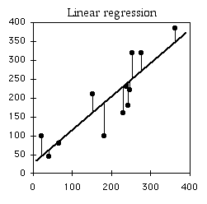
An Example…
One example that many of you will be familiar with is a (Least Squares) Regression Model
Given a set of data – with one continuous input variable, and one continuous output variable, we may then visually determine that the “best” model is the linear model – and we then attempt to fine tune the fit of this model by adjusting m and b (slope and intercept from y=mx+b ) to best fit (least error) the predicted values to the observed values
inputs
Take inputs and use
a linear model to predict target values…
Difference between
Predicted and Observed Target values are Errors
target
predictions
errors
The smaller the error the better the fit to the given data
Using Regression, we
develop a prediction
model …
Prediction=β₀+β₁(input)
(simply another form of y=mx+b)

Slide 22
Let’s test our understanding

Slide 23
Q1: When we fit a linear regression model to the data
We are attempting to select the best model.
We are attempting to identify the parameter values for a selected model that best fits the data.
Both a and b
None of the above

Slide 24
Q2: What’s our primarily objective when conducting predictive modeling?
Given a set of input variables, develop a model that accurately predicts target variables.
Develop a model that best fits your current data.
Accurately predict input variables
Describe the data in ways that generate new insights

Slide 25
Q3: The variables that we identify and use to predict values of target variables are called:
Big Data
Categorical Data
Continuous Variables
Input Variables

Slide 26
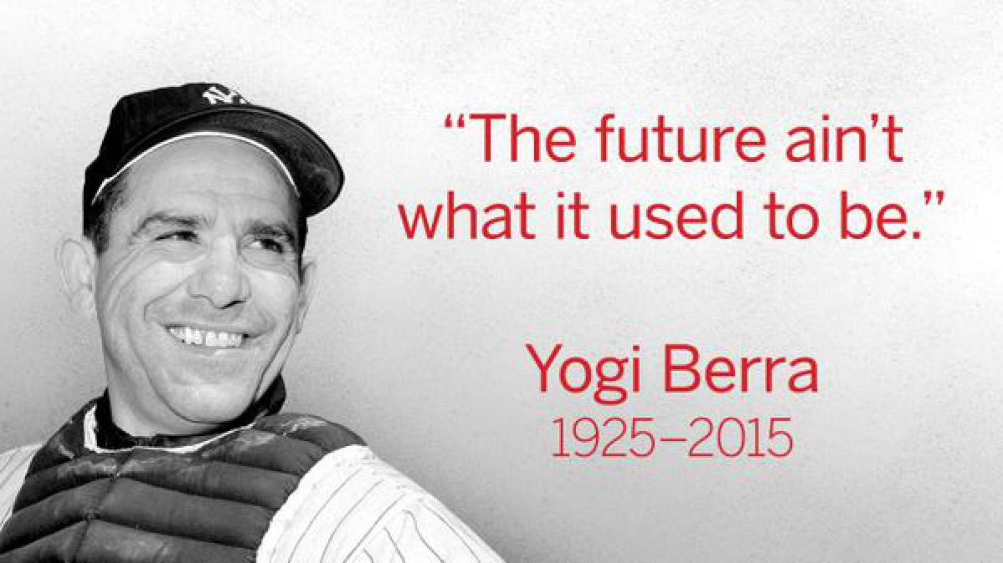
Now, let’s focus on two important issues in predictive analytics that set it apart from descriptive analytics…

Slide 27
Let’s ‘try’ to predict the future …
For demonstration purposes, I’ve created a data generating stochastic process that I will attempt to identify using regression analysis.

Slide 28
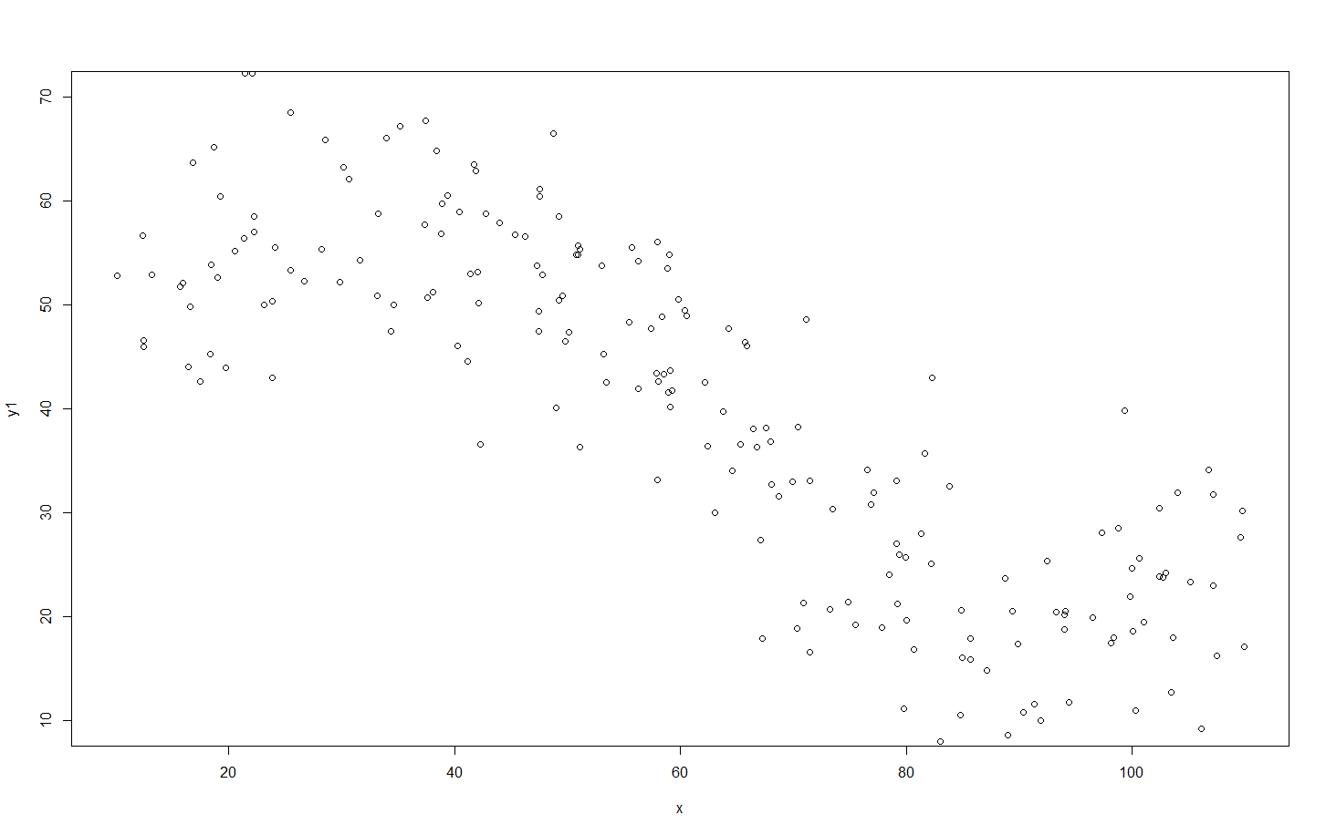
Using this process, I generate 200 observations…

Slide 29
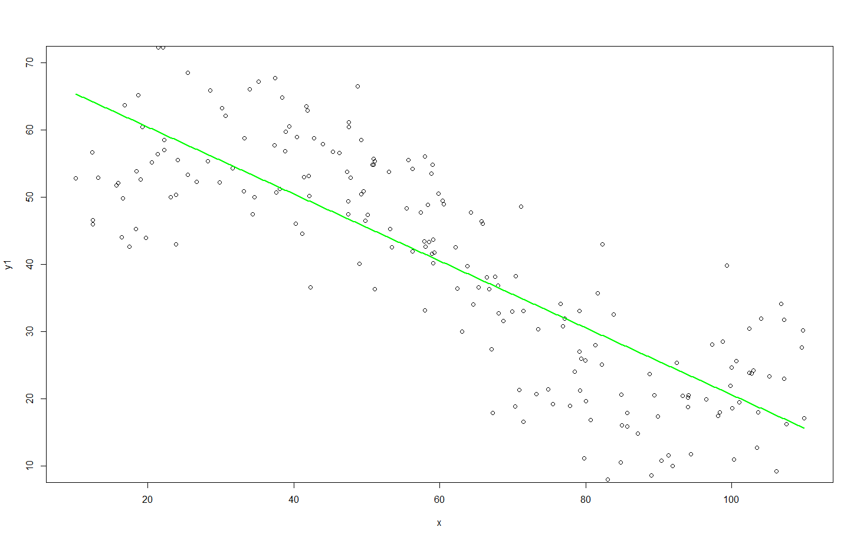
I fit my 1st Candidate Model to this “training” data:
Y=β₀+β₁x
Y=70.3-0.51x
Root Mean Squared Error = 10.71

Slide 30
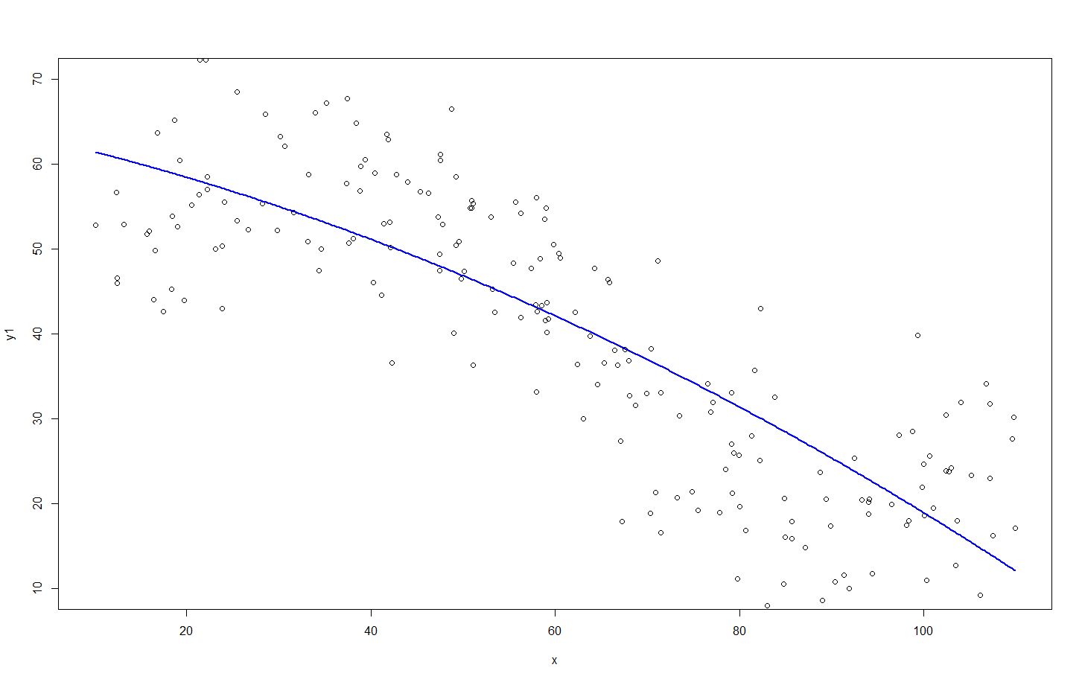
…Then, my 2nd Candidate Model:
Y=β₀+β₁x + β₂x²
Y=63.8-0.22x-0.002x²
Root Mean Squared Error = 9.94

Slide 31
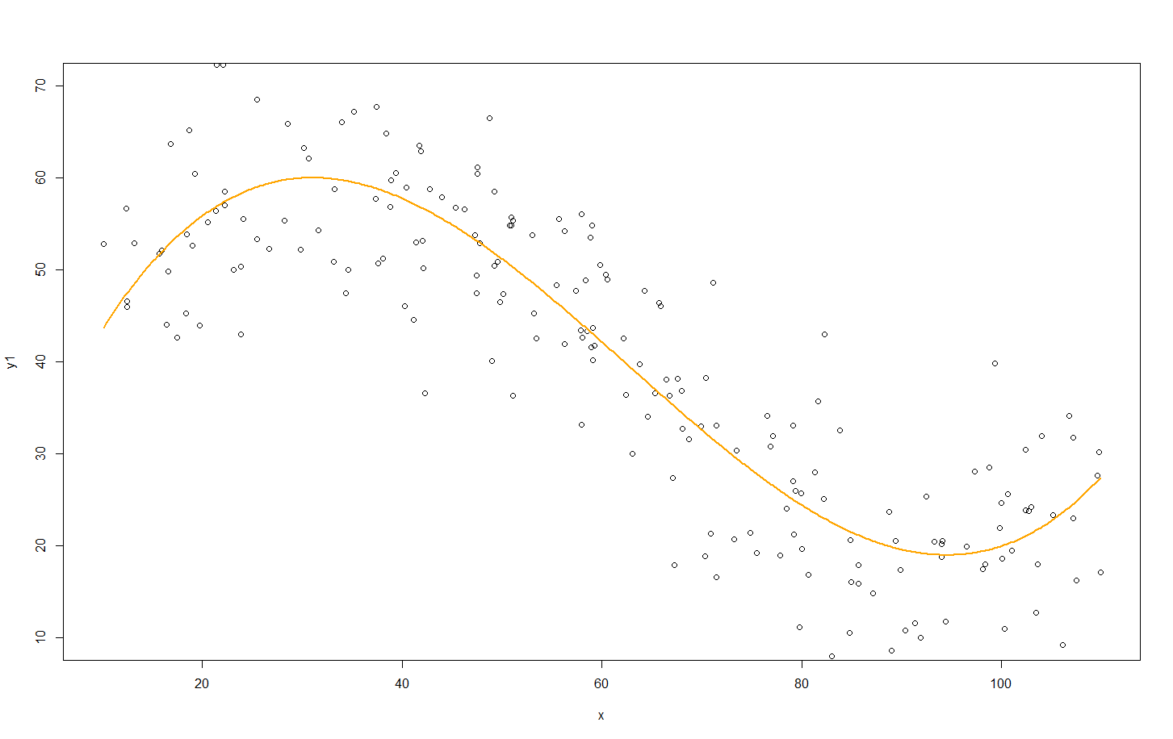
3rd Candidate Model:
Y=β₀+β₁x +β₂x²+β₃x³
Y=24.4+3.66x-0.058x²+0.0003x³
Root Mean Squared Error = 7.64

Slide 32
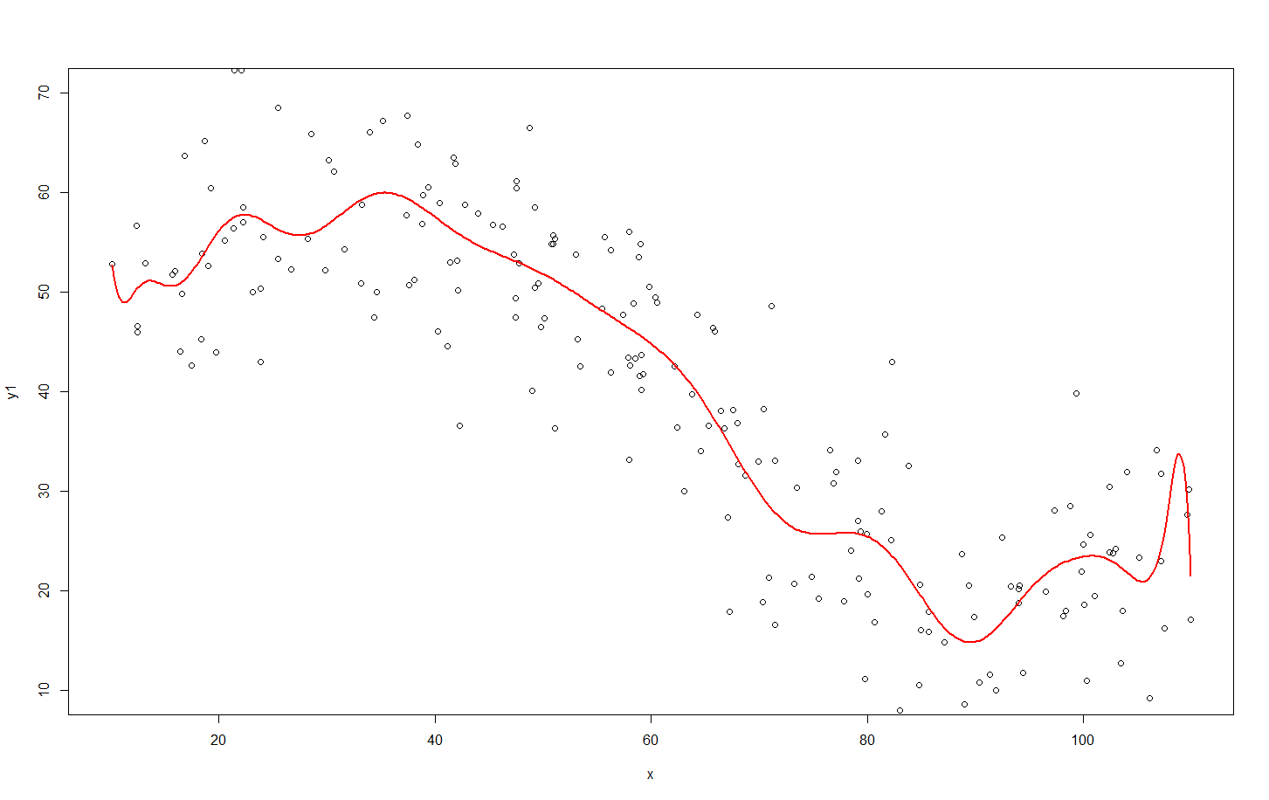
4th Candidate Model:
Y=β₀+β₁x +β₂x²+β₃x³+ β₄x⁴+β₅x⁵+ β₆x⁶+β₇x⁷+ β₈x⁸+β₉x⁹+ β₁₀x¹⁰+β₁₁x¹¹+ β₁₂x¹²+β₁₃x¹³+ β₁₄x¹⁴+β₁₅x¹⁵+ β₁₆x¹⁶+β₁₇x¹⁷+ β₁₈x¹⁸+β₁₉x¹⁹+ β₂₀x²⁰
Y=11490-4490.9x +777.3x²-78.1x³+ 5.1x⁴-0.29x⁵+ 0.007x⁶-0.00017x⁷+ 2.7*10⁻⁶x⁸-3.12*10⁻⁸x⁹+ … -1.97*10⁻²⁴x²⁰
Root Mean Squared Error = 7.38

Slide 33
The “Best” Performing Model…
Set of Predictive Models | Model Fit on Training Data (Root Mean Square Errors)
#1) Y=β₀+β₁x | 10.71
#2) Y=β₀+β₁x β₂x² | 9.94
#3) Y=β₀+β₁x +β₂x²+β₃x³ | 7.64
#4) Y=β₀+β₁x +β₂x²+β₃x³+ β₄x⁴+β₅x⁵+ β₆x⁶+β₇x⁷+ β₈x⁸+β₉x⁹+ β₁₀x¹⁰+β₁₁x¹¹+ β₁₂x¹²+β₁₃x¹³+ β₁₄x¹⁴+β₁₅x¹⁵+ β₁₆x¹⁶+β₁₇x¹⁷+ β₁₈x¹⁸+β₁₉x¹⁹+ β₂₀x²⁰ | 7.38

Slide 34
So, which is the better predictive model? To identify this, we need to understand how to systematically balance between complexity, and guarding against under/over fitting

Slide 35
Some approaches to this…
Big Data: With more and more data, law of large numbers tells us that is should become more and more representative of there “true” model (distribution).
Could you ever have “enough”? And if you did, would you have the resources to process this in a timely fashion?
What about drift? Maybe the real-world model in which you are attempting to identify is changing?
Penalize complexity: To combat overly-flexible models, apply some penalty for complexity (i.e. Put limits on number of parameters, levels, etc.)
This is a rather arbitrary call, but can work on certain data sets where visualization and intuition (like in our previous example) can be applied. But, the limits used can often be inappropriate… we are attempting to limit such “from the gut” evaluations.
Cross-validation: Divide data into two parts. Call one part the training set, and the other the validation set. Develop the model on the training set, and assess performance on the validation set.

Slide 36
…let’s elaborate on this last approach (which is arguably the best overall approach, and one that you’ll commonly use)

Slide 37
Data Splitting and “Right” Fitting Honest Testing of our Predictive Model
Validation
Training
Test

Slide 38
Addressing issues of fit and complexity
The training set is used to determine the best fitting parameters for each of our models.
The validation set allows us to test each model against new data, and determine the best performing model.
The test set allows us to conduct an honest assessment (or scoring) of how well the selected model performs. Our goal is to verify if the accuracy is sufficient.
Application phase is the deployment and use of the model. If the performance of the model becomes unsatisfactory (especially is the population “drift”), revisit the model development process

Slide 39
Data Partitioning
Training Data
Original Data
inputs
target
inputs
target
Validation Data
inputs
target
Test Data
inputs
target
Three data sets (Training, Validation, and Test) are sampled from the original data sets.

Slide 40
Predictive Model Sequence
Training Data
Validation Data
inputs
target
inputs
target
1
2
Using the training data create a number of potential models – some of which more complex than others
3
4
5
Model
Complexity

Slide 41
Model Performance Assessment
Training Data
Validation Data
inputs
target
inputs
target
1
Rate model performance using validation data.
2
3
4
5
Model
Complexity
Validation
Assessment

Slide 42
Model Selection
Training Data
Validation Data
inputs
target
inputs
target
1
Select the simplest model with the highest validation assessment.
2
3
4
5
Model
Complexity
Validation
Assessment

Slide 43
“Honestly” Assessing Selected Model Performance
Training Data
Test Data
inputs
target
inputs
target
Rate the models performance on a test set of data… A set of data not used in the training of the model or to cross validate the model.
3

Slide 44
The “Best” Performing Model…
Using the four models that “I fitted” to the training data, I test the fit of each model on a new batch of data (produced by the same stochastic process that I used to generate the first batch)…
Set of Predictive Models | Model Fit on Training Data (Sum of Squared Errors) | Model Fit on Validation Data (Sum of Squared Errors)
#1) Y=β₀+β₁x | 10.71 | 10.31
#2) Y=β₀+β₁x β₂x² | 9.94 | 10.21
#3) Y=β₀+β₁x +β₂x²+β₃x³ | 7.64 | 8.99
#4) Y=β₀+β₁x +β₂x²+β₃x³+ β₄x⁴+β₅x⁵+ β₆x⁶+β₇x⁷+ β₈x⁸+β₉x⁹+ β₁₀x¹⁰+β₁₁x¹¹+ β₁₂x¹²+β₁₃x¹³+ β₁₄x¹⁴+β₁₅x¹⁵+ β₁₆x¹⁶+β₁₇x¹⁷+ β₁₈x¹⁸+β₁₉x¹⁹+ β₂₀x²⁰ | 7.38 | 9.19
NOTICE: Notice that I’m only using training and validation data. This is quite common and approach. Therefore, it can be confusing on when we should use a test. This “depends” on our goals, and the size and quality of your dataset.

Slide 45
The “Best” Performing Model…
Set of Predictive Models | Model Fit on Training Data (Sum of Squared Errors) | Model Fit on Validation Data (Sum of Squared Errors)
#1) Y=β₀+β₁x | 10.71 | 10.31
#2) Y=β₀+β₁x β₂x² | 9.94 | 10.21
#3) Y=β₀+β₁x +β₂x²+β₃x³ | 7.64 | 8.99
#4) Y=β₀+β₁x +β₂x²+β₃x³+ β₄x⁴+β₅x⁵+ β₆x⁶+β₇x⁷+ β₈x⁸+β₉x⁹+ β₁₀x¹⁰+β₁₁x¹¹+ β₁₂x¹²+β₁₃x¹³+ β₁₄x¹⁴+β₁₅x¹⁵+ β₁₆x¹⁶+β₁₇x¹⁷+ β₁₈x¹⁸+β₁₉x¹⁹+ β₂₀x²⁰ | 7.38 | 9.19
Increasing
Complexity
Better fit
Worse fit
What’s going on here is that most complicated model — in this case, the 20th order polynomial— is not fitting the generalizable features of the data. Instead, this model is fitting the sampling noise, or the accidents which don’t repeat.
In general complex models tend to over- fit the data. Conversely, models that are too simple may not describe the generalized features of the data with sufficient detail, and thus results in under-fitting.

Slide 46
Apply this algorithm to our previous example…
Set of Predictive Models | Model Fit on Training Data (Sum of Squared Errors) | Model Fit on Validation Data (Sum of Squared Errors)
#1) Y=β₀+β₁x | 10.71 | 10.31
#2) Y=β₀+β₁x β₂x² | 9.94 | 10.21
#3) Y=β₀+β₁x +β₂x²+β₃x³ | 7.64 | 8.99
#4) Y=β₀+β₁x +β₂x²+β₃x³+ β₄x⁴+β₅x⁵+ β₆x⁶+β₇x⁷+ β₈x⁸+β₉x⁹+ β₁₀x¹⁰+β₁₁x¹¹+ β₁₂x¹²+β₁₃x¹³+ β₁₄x¹⁴+β₁₅x¹⁵+ β₁₆x¹⁶+β₁₇x¹⁷+ β₁₈x¹⁸+β₁₉x¹⁹+ β₂₀x²⁰ | 7.38 | 9.19
✓
Using this mode performance assessment, through a systematic evaluation we identify the 3rd model as our best candidate “predictive” model.

Slide 47
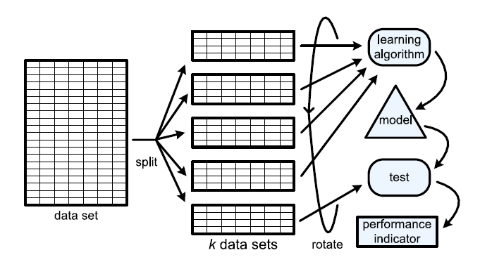
K-fold Cross Validation
Learning Algorithms can also take an approach of splitting the data multiple times, thus creating many different (yet from the same population) training and validation sets. The “k-fold cross validation” approach, in general, can result in identifying a more reliable (better performing when faced with new data) predictive model.
(source: Van der Aalst, W. (2011). Process mining: discovery, conformance and enhancement of business processes.)

Slide 48
Summary - Key Issues in Predictive Analytics
Two important issues that we need to consider for all modeling in predictive analytics…
Data “Fit”:
Over-Fitting: If our model is too specific in describing our existing/current data that we have used to fit our model, we may limit the models ability to predict data that we have not yet evaluated.
Under-Fitting: If our model is too general, we may limit the models ability to accurately predict data that has not yet been seen.
Model complexity:
Complex models introduce more assumptions than less complex models. Therefore, within reason, less complex models are preferred.
Complex models are more difficult to interpret, communicate and understand.
Complex models require more processing, and for time sensitive forecasts, this can be a big deterrent.
But, simple models may not capture the patterns exhibited by any underlying process or relationship being observed.
Giving in the Sirens song
Ignoring the evidence.

Slide 49
Let’s test our understanding
The best model is the
simplest model with the best performance on the training data.
simplest model with the best performance on the validation data.
most complex model with the best performance on the training data.
most complex model with the best performance on the validation data.

Slide 50
For Next Class: Scikit Learn
We will be using the machine learning package “Scikit Learn”
We will focus on supervised learning only, and on two methods – regression and classification (decision trees).
To read more on this machine learning package see here…
http://scikit-learn.org/stable/tutorial/basic/tutorial.html

